Slide 1
Guide to Chris’ Single Cell Snakemake Pipelines
2023-06-12

Slide 2
Index
Cell Ranger
mkfastq (3 slides)
count/multi (6 slides)
Snakemake overview (3 slides)
Get the code
Location on Locus
GitHub
Pipeline files
Prepare configuration files
Pipeline config file (2 slides)
Project config file (2 slides)
Run Snakemake
Sample Sheet

Slide 3
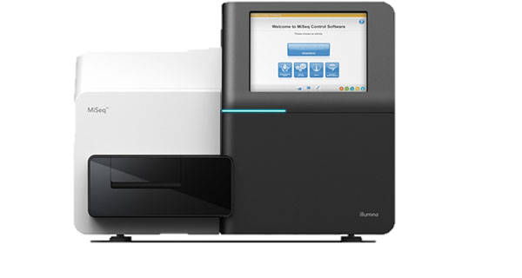

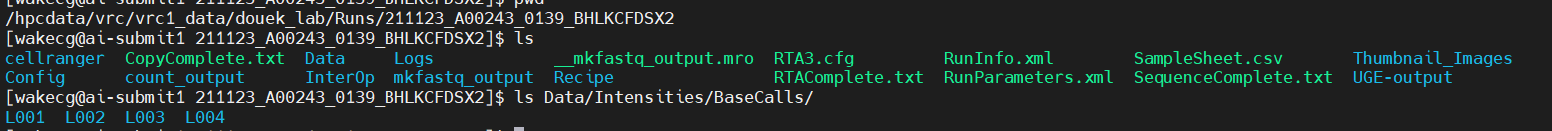
BCL (binary base call) format
BCL Files are generated in Real time at each cycle of sequencing
Illumina sequencing machine
Color | Base | Confidence | Position
R | A | 80% | Lane 1
Y | C | 73% | Lane 1
B | T | 65% | Lane1
R | A | 82% | Lane 1
G | G | 90% | Lane1
… | … | … | …
1 cycle = 1 bp being read.
Example raw sequencing output, located in douek_lab directory on Locus:

Slide 4
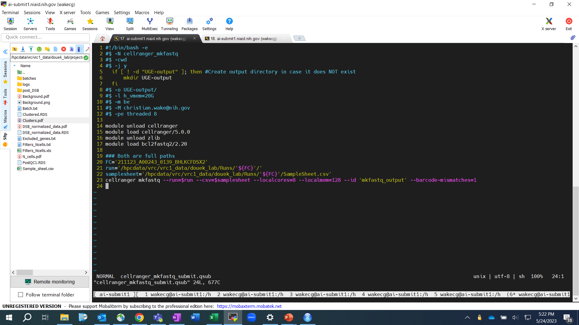
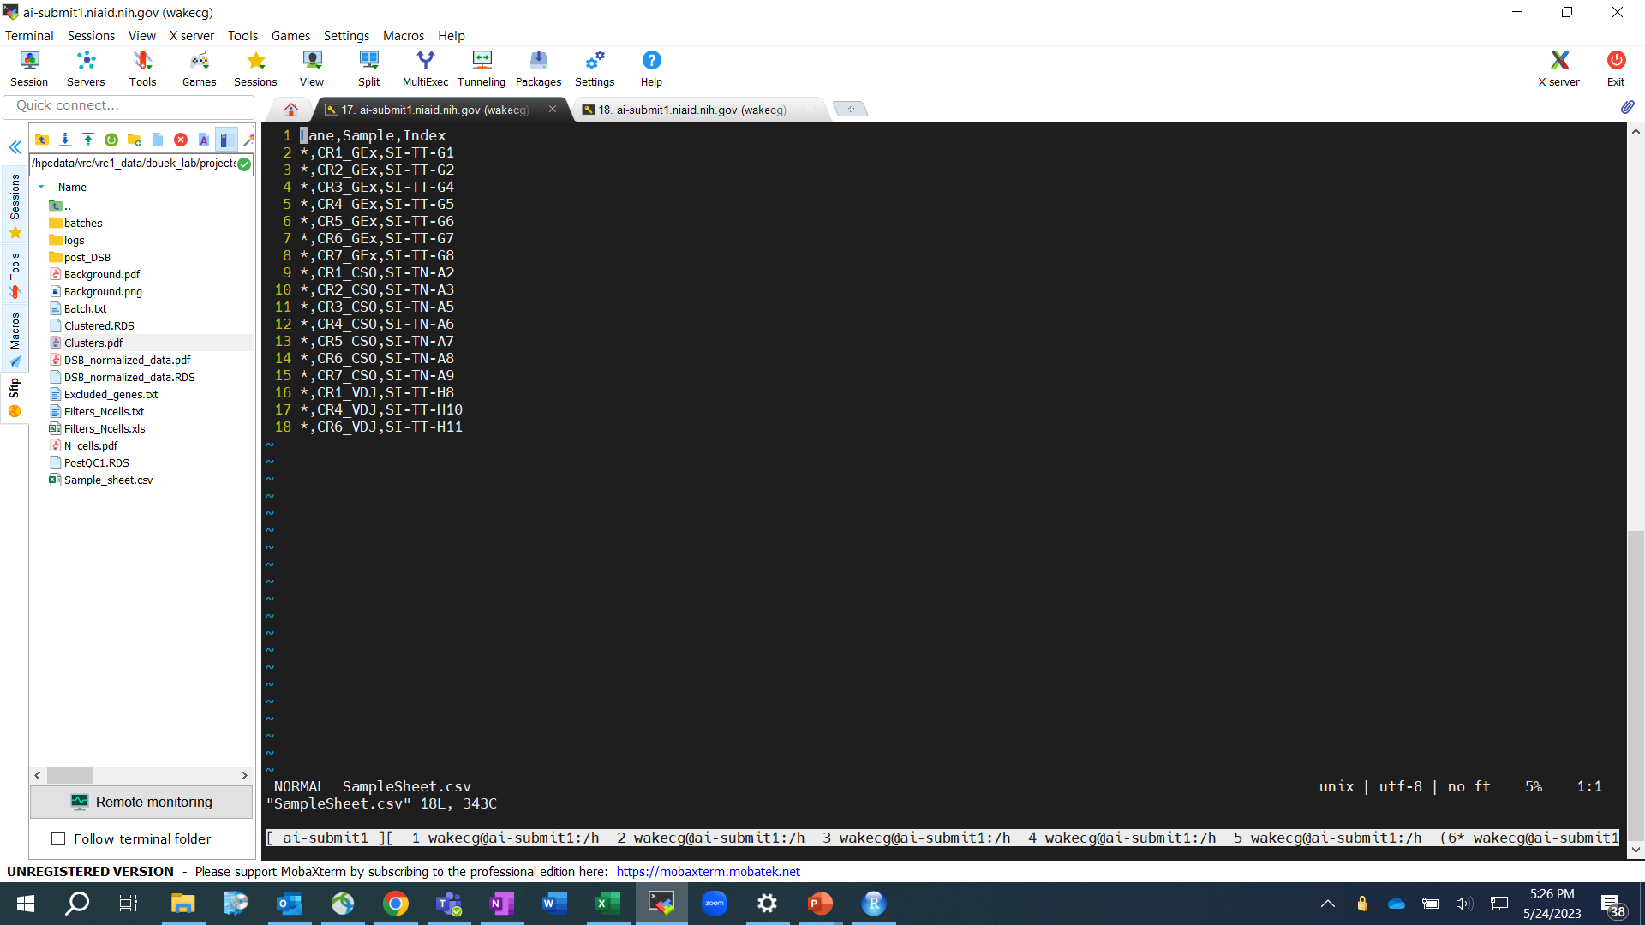
Cell Ranger mkfastq
The 10x Genomics sample index that was used in library construction
BCL -> Fastq

Slide 5
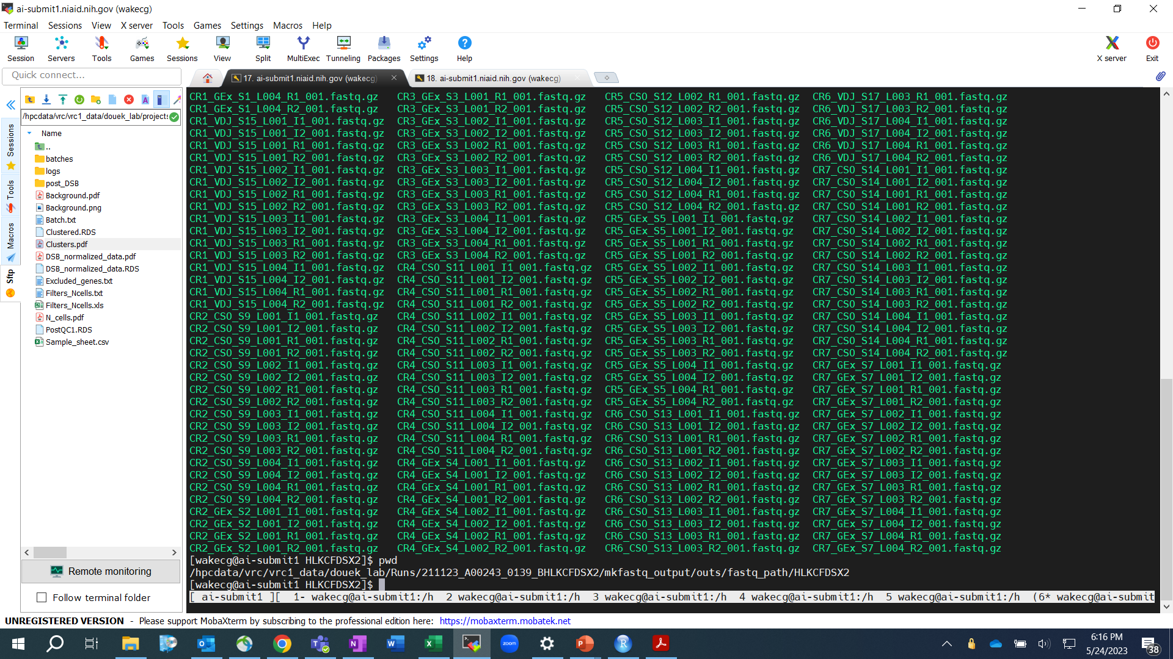
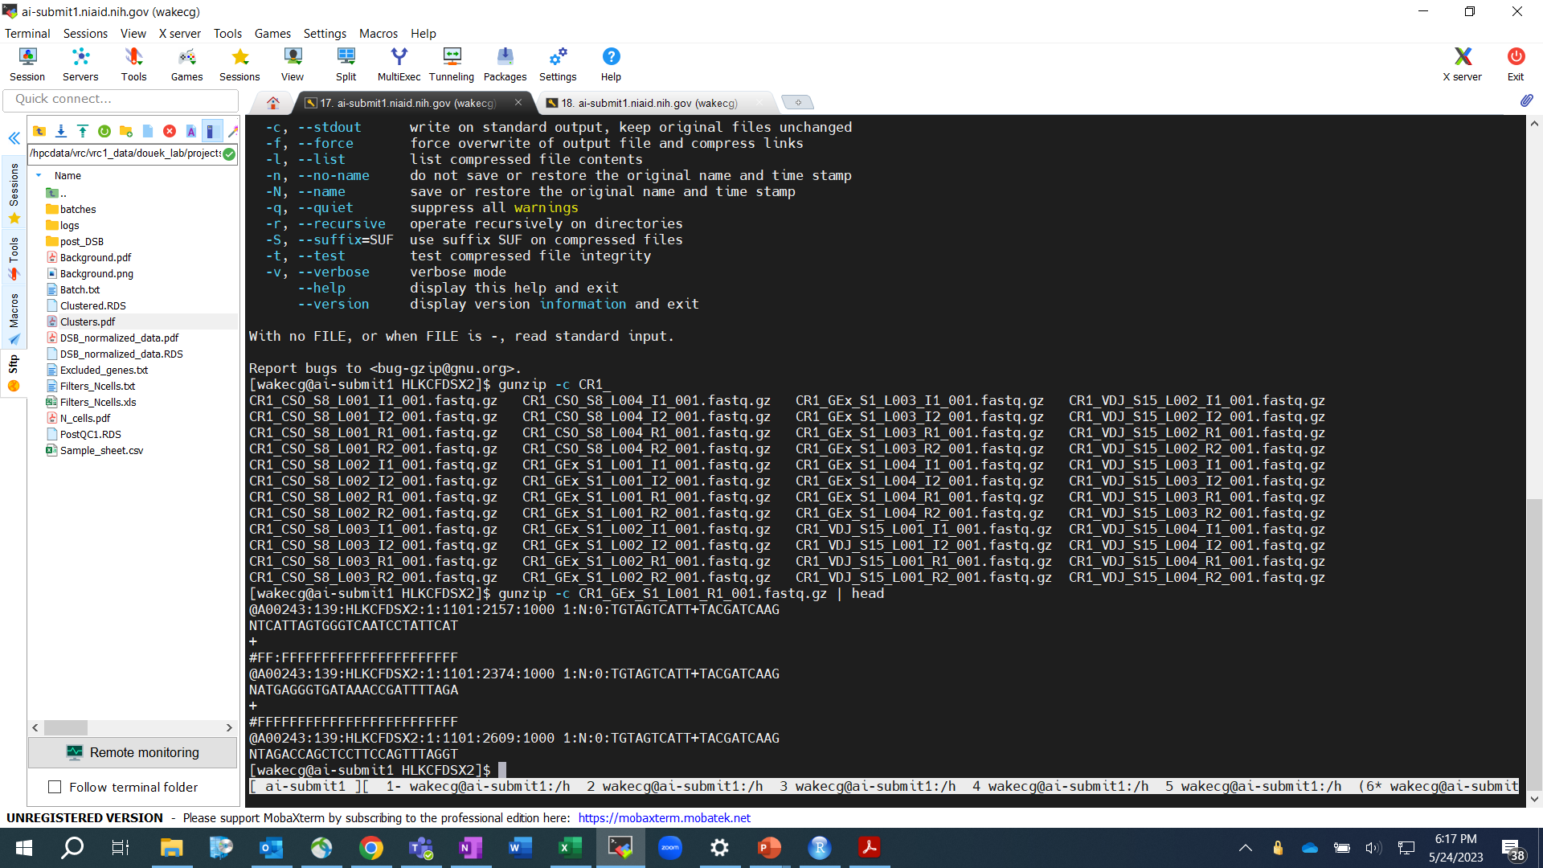
Mkfastq output

Slide 6
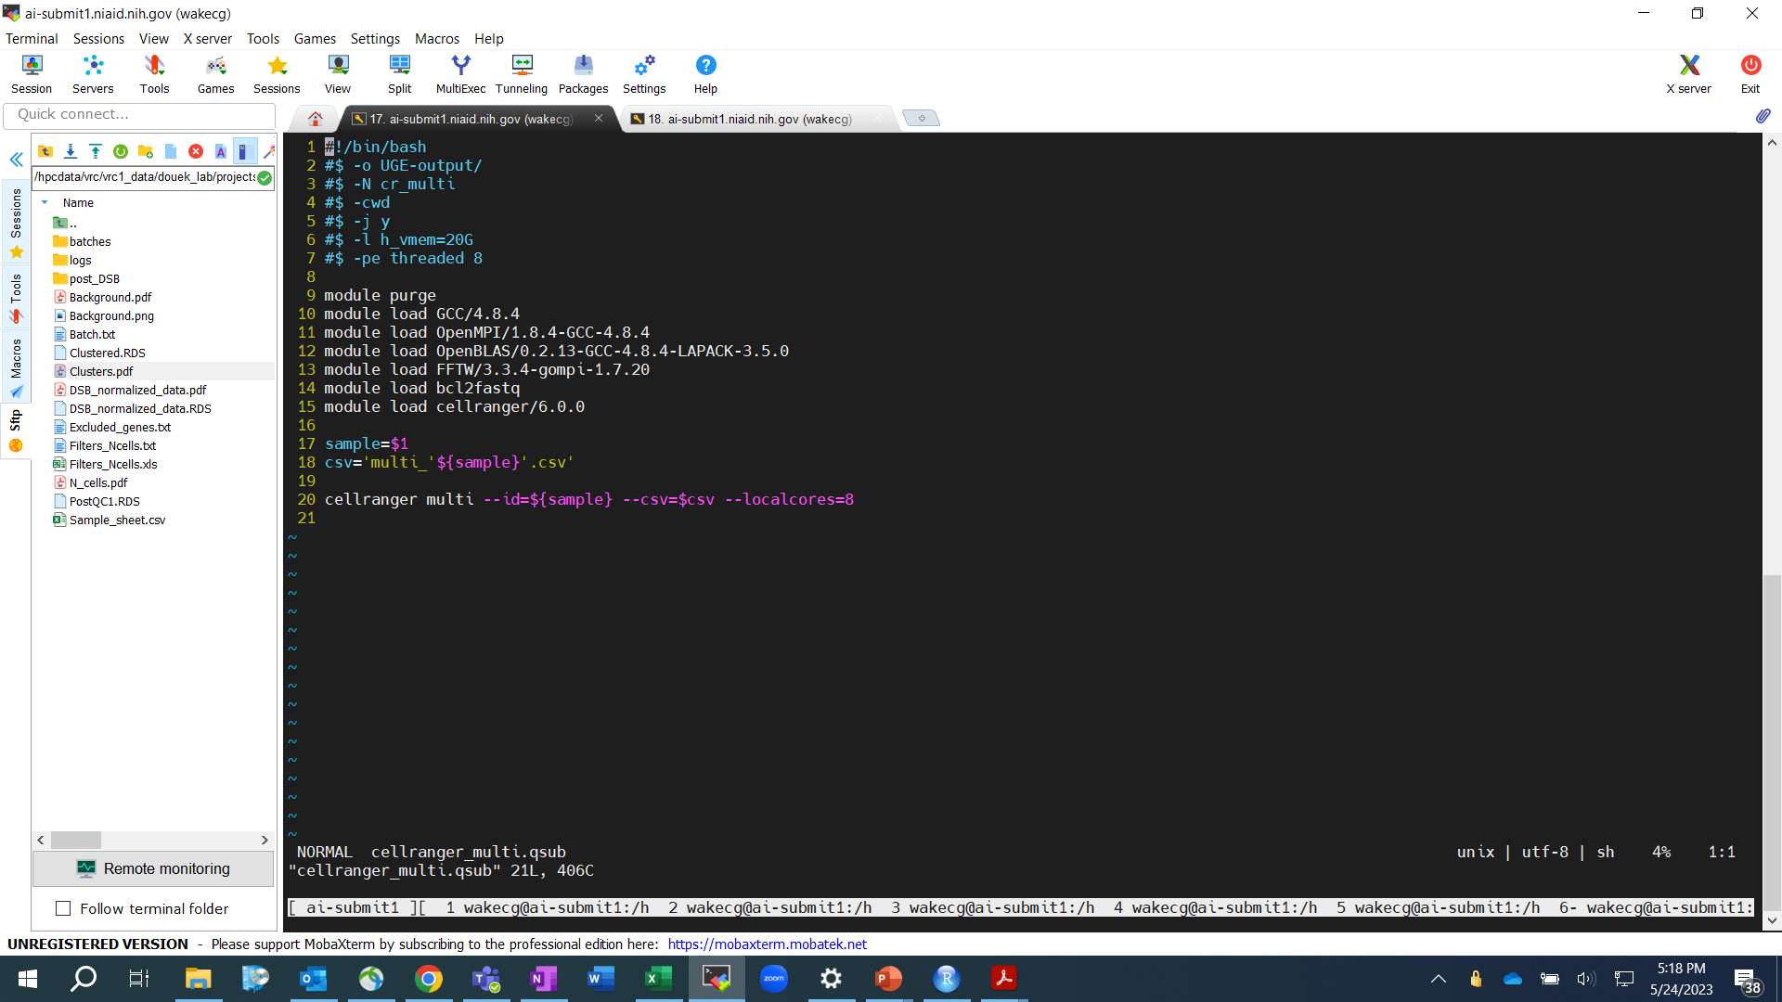
Cell Ranger multi
Alignment to reference
Read filtering
Barcode and UMI counting

Slide 7
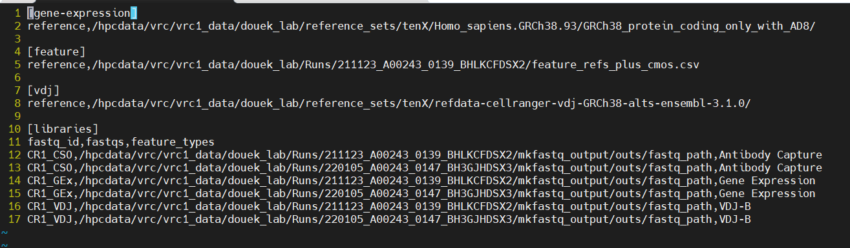
Cell Ranger multi sample sheet

Slide 8
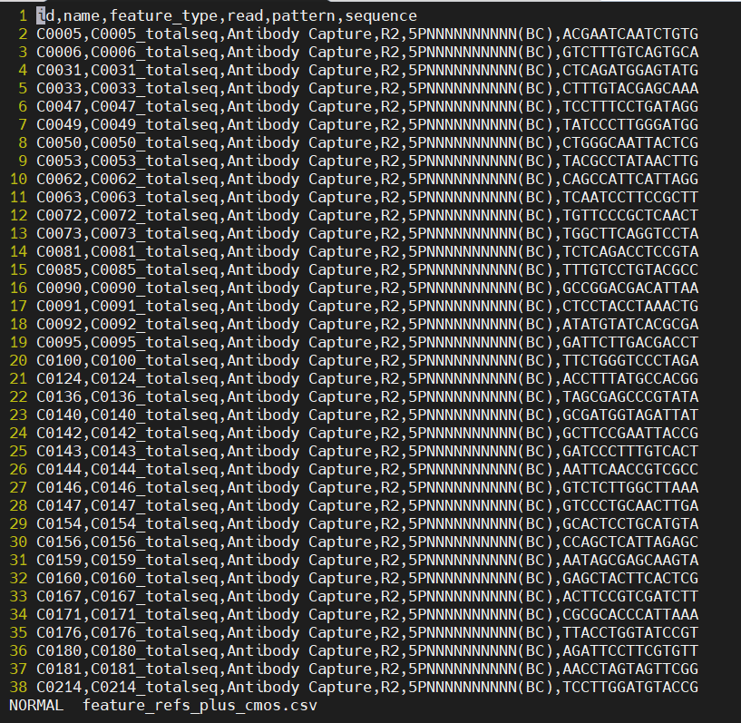
Feature reference (csv)

Slide 9
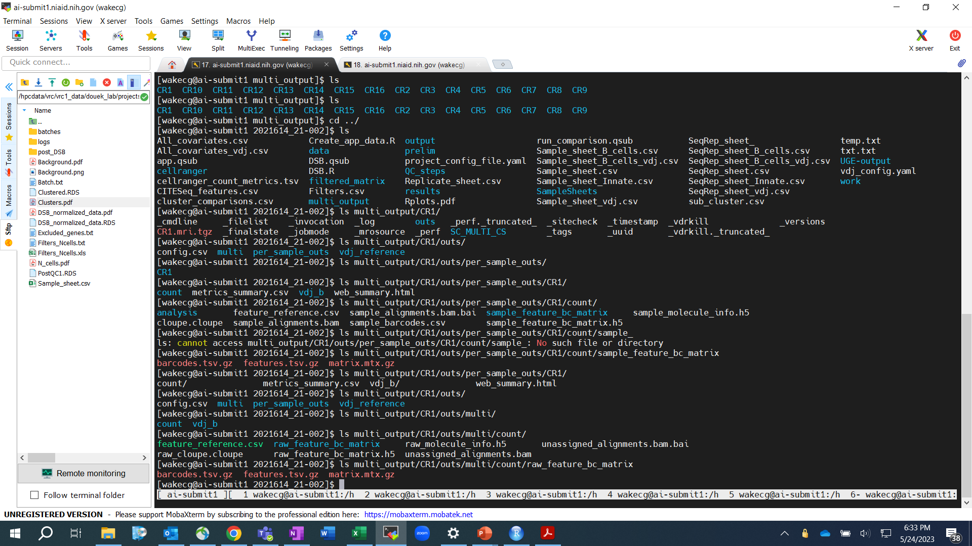
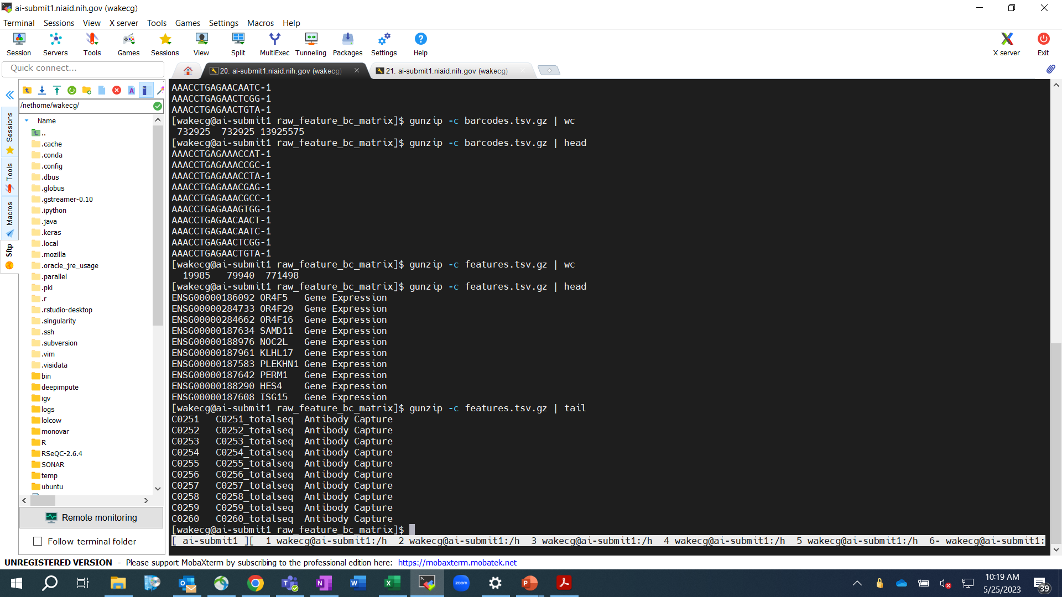
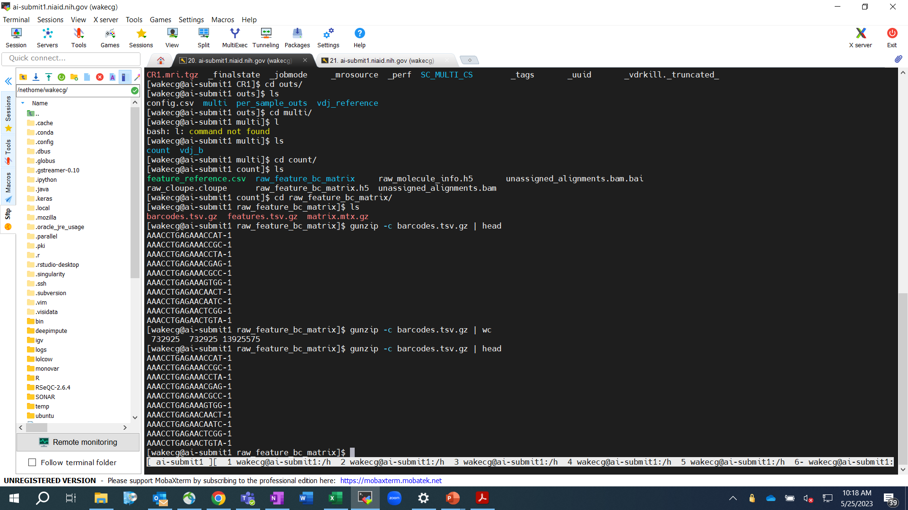
Cell Ranger multi output
Note: Put individual sample outputs into a subdirectory: “multi_output” or “count_output”
in either the Runs or the project directory

Slide 10
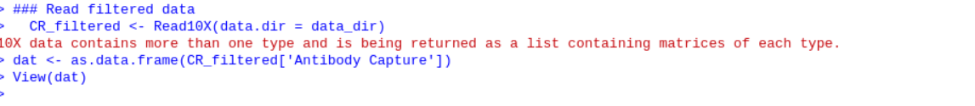
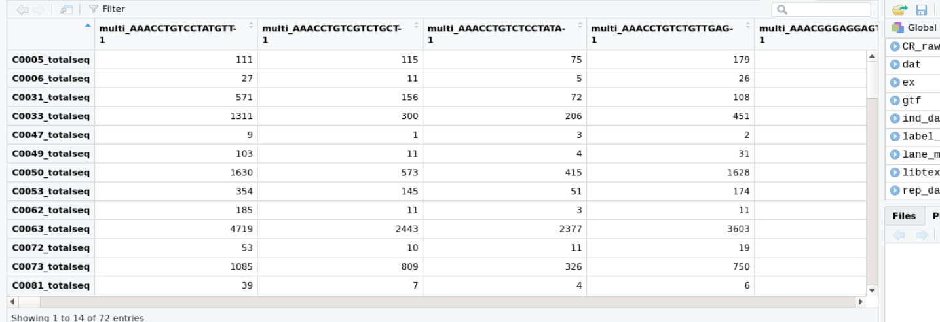
CR multi output into R

Slide 11
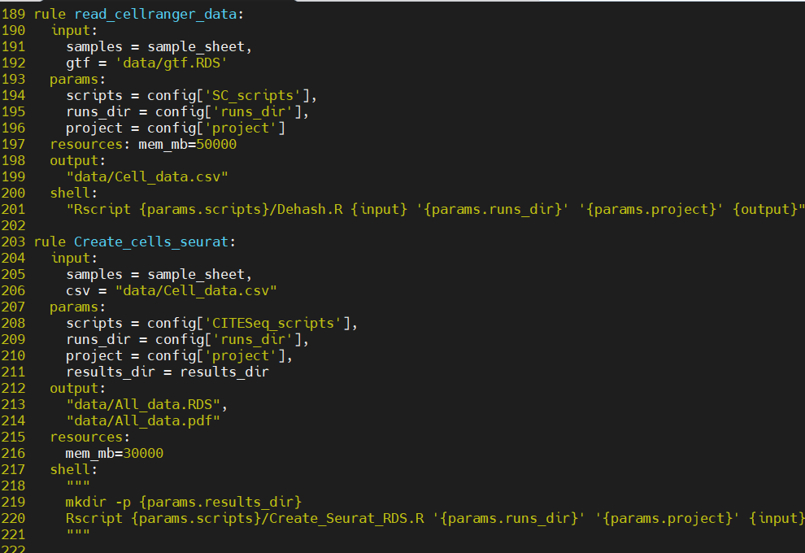
…which is used by the snakemake pipeline

Slide 12
Sample sheets are confusing
Cell Ranger mkfastq
Per-flowcell sample sheet
Lane, Sample Name, Sample Index
Cell Ranger multi
Per-sample sample sheet
Info per-data type
Reference to use
Fastq location
Snakemake
Per-project sample sheet
All the above info plus everything else - subject ID, time point, test variables, hashes etc.

Slide 13
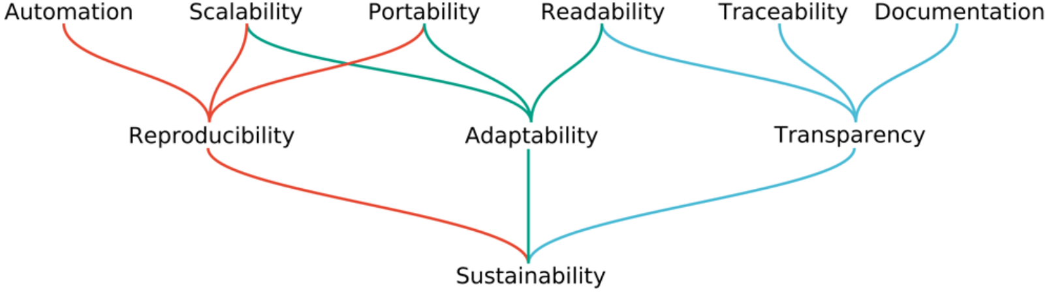
Snakemake
https://snakemake.readthedocs.io/en/stable/
Purpose of a workflow management system:

Slide 14
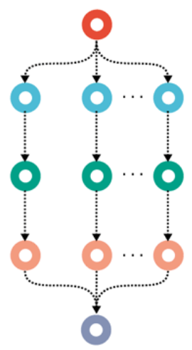
Workflow structure by a set of “rules”
Rules
Mainly defined by their 1) input, 2) output and 3) the way to create one from the other
That is enough for Snakemake to connect multiple rules in a sequence or a tree structure
3) is usually the line following “shell:” meaning it is a bash command, or if it just runs python code “run:”
Other optional lines you may see are: params, resources
Snakefile
Rules are defined in one or more “Snakefiles”, written in python*
Order of rules in the file is not important, except maybe for human-readability
Before rules, Snakefiles may have preparatory python code, doing things like reading configuration files, defining file paths from those, and defining functions that rules will use.
Directed Acyclic Graph
(DAG)
*python is the base, but there are some Snakemake-specific syntax

Slide 15
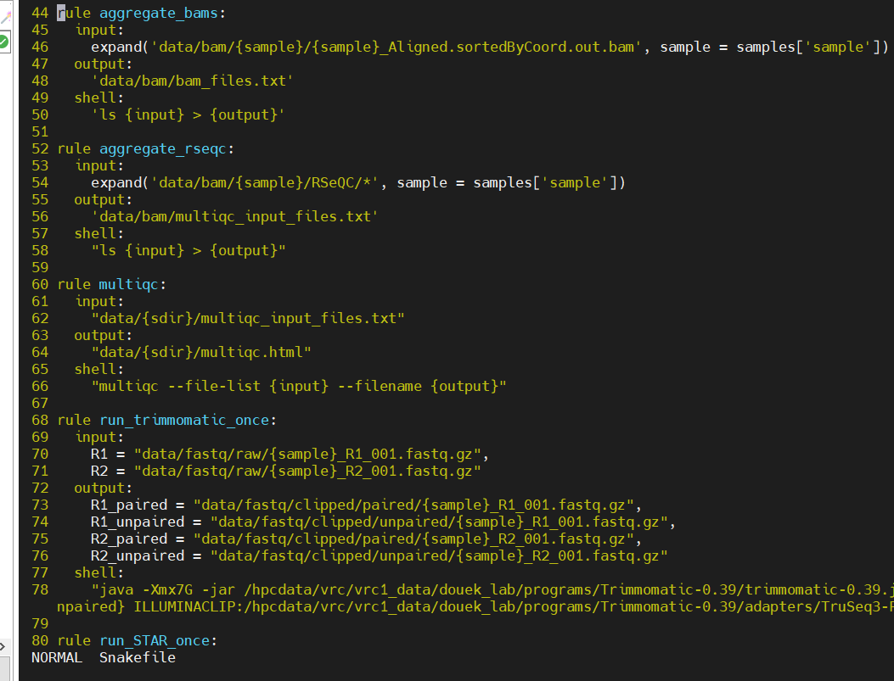
Rule format
Rule rule_name:
input:
“File_A.txt”
output:
“File_B.txt”
shell:
“cp {input} {output}”
This rule would create File_B.txt by copying File_A.txt. Snakemake will only do this if File_A.exists but File_B.txt does not, or if they both exist but File_B.txt is newer than File_A.txt.
The indentations are important. Python uses them to indicate blocks of code. The number of spaces must be consistent.

Slide 16
Get the code on Locus
You’ll need the pipeline code on Locus so you can have it submit jobs to the computing clusters
To do this you have at least 3 options:
1. Directly call snakemake using the Snakefile’s where I do: /hpcdata/vrc/vrc1_data/douek_lab/snakemakes/SingleCell/
2. Copy the above directory so somewhere you prefer it, like your home directory
3. Pull the code from the GitHub URL (see the next slide) to somewhere you’d like it, like your home directory
Options 1) and 2) both risk that you’re using some code that currently broken, since that’s where I’m testing it. But the code on GitHub should be a working version.

Slide 17
GitHub directions
To get the code:
Ask Chris to add you as a “Collaborator” to the GitHub repository, otherwise the link below will give a 404 error.
On https://github.com/christianwake/VRC_SC.git, fork the repository on the top right by clicking "fork"
Command line: git clone https://github.com/yourusername/VRC_SC.git
Asks for username and password (need to create personal key / token as the password)
Navigate to cloned directory on command line (cd VRC_SC)
To edit and contribute to the code:
Create a new “branch” to VRC_SC by: git branch ‘newbranchname’
Enter new branch by: git checkout ‘newbranchname’
To make changes to existing file: git add ‘existing_filename’
Save file as usual depending on text editor after changes are made
Commit changes and add one liner on what you changed: git commit -m "Added a new line in existing_filename"
Check status of branch to make sure it's the right branch: git status
Push the changes: git push --set-upstream origin 'newbranchname'
Remote for fork: git remote -v
git remote add upstream https://github.com/christianwake/VRC_SC.git
Sync fork with upstream and original repository: git fetch upstream
Switch to local main branch & merge main repository changes to local/upstream main branch: git checkout main
git merge upstream/main
Create a pull request for 'newbranchname' on GitHub by visiting: https://github.com/yourusername/VRC_SC/pull/new/'newbranchname'/

Slide 18
The snakefile directories
In the SingleCell snakemake directory (either in douek_lab/snakemakes/ or wherever you copied it), there are multiple single-cell pipelines, each consisting of a Snakefile and a scripts/ directory full of mainly .R files
SmartSeq, TenX and CITESeq each have a subdirectory that contain those.
The main directory also has a Snakefile and a scripts subdirectory, that have snakemake rules and R scripts that are used in common by the different pipelines.
When you call snakemake you will refer it to the specific subdirectories’ Snakefile, e.g. for CITESeq refer SingleCell/CITESeq/Snakefile, using its full path

Slide 19
Pipeline config file
This file is how you tell snakmake how to submit jobs on Locus, and a few other more minor parameters
If you put it in the right place, snakemake can find it automatically
It goes in your main home directory on Locus:
/nethome/{user_name}/.config/snakemake/{pipeline_name}/config.yaml
e.g. my user name is wakecg, so my CITESeq pipeline config file is here:
/nethome/wakecg/.config/snakemake/CITESeq/config.yaml
Note that
You can navigate to your main home directory by using “cd” without specifying where
Directories preceded by a period, like .config won’t show up by default using “ls” but you can navigate there just fine
You will have to create the snakemake and CITESeq subdirectories with “mkdir”
The config file needs to be named config.yaml exactly
Yaml is a specific format, so be careful if you modify the example config.file

Slide 20
Example pipeline config.yaml
Example pipeline config file is located here:
/hpcdata/vrc/vrc1_data/douek_lab/snakemakes/examples/config.yaml
BUT REPLACE “wakecg” WITH YOUR LOCUS USERNAME
Its text is:
cluster: qsub -l h_vmem=$(({resources.mem_mb} / 1000))G -o /hpcdata/vrc/vrc1_data/douek_lab/wakecg/snakemake_logs/ -e /hpcdata/vrc/vrc1_data/douek_lab/wakecg/snakemake_logs/
jobs: 50
restart-times: 0
default-resources:
mem_mb=8000

Slide 21
Project configuration file
Example file:
/hpcdata/vrc/vrc1_data/douek_lab/snakemakes/examples/project_config_file.yaml
It should be located in whatever directory you will be running snakemake from, probably your directory dedicated to the particular project
Each line in the file defines one project-specific parameter that the Snakefile will use, oftentimes passing to an R script to be used
Any parameter that is accessed in the Snakefile by the python object called “config” should be in the project config file, e.g. accessing project name by config[‘project’]
Exceptions are those that can have an assumed default value, either in the Snakefile’s prep python code, or in the Rscript that uses it. If the value is not in the config file it will be assumed. E.g. clustering resolution can be assumed as a standard value, and then you can enter in a specific value when you want to tweak it

Slide 22
An incomplete list of all the required config file parameters
project
sample_sheet
runs_dir
SC_scripts
{Pipeline_name}_scripts
QC_name
QC_file
test
refgtf

Slide 23
Running snakemake
First, navigate to your project directory, e.g.
/hpcdata/vrc/vrc1_data/douek_lab/projects/RNASeq/{project_name}
Load the snakemake module
module load snakemake
Call snakemake, specifying the pipeline Snakefile and the pipeline name for the pipeline config.yaml file
snakemake --snakefile /hpcdata/vrc/vrc1_data/douek_lab/snakemakes/SingleCell/CITESeq/Snakefile --profile CITESeq –np

Slide 24
Dry run and test run
Dry run
I suggest first running it with that “-np”, which means do a dry run and tell you what jobs it would submit but don’t submit them.
If the dry run doesn’t have an error, and you should see a partial snakemake output which will show you a list of rules that will be run in green text
Test run
Snakemake knows which rules to run based on what output you ask it to produce. If you don’t specify one (like in my example on the previous slide) it assumes you want to whole thing, the input to the first rule, called “All”. But you probably don’t want the whole thing just yet.
I suggest first specifying that you just want the output of the rule “make_gtf_R_object”, which has one input file and one output file.
The input file is the full path the a gtf file you specified in the project config file under the name 'refgtf’
The output is 'data/gtf.RDS’ relative to your current working directory, which should be your project directory
The qsub log files will be in the log file specified in the pipeline config file, which should be something like:
/hpcdata/vrc/vrc1_data/douek_lab/username/snakemake_logs/
So, a dry test run would be submitting this line:
snakemake --snakefile /hpcdata/vrc/vrc1_data/douek_lab/snakemakes/SingleCell/CITESeq/Snakefile --profile CITESeq –np data/gtf.RDS

